Slide 1


Welcome Everyone!
We’ll be starting at 10:05 AM PDT

Slide 2
The National Research Platform
Fall Training Series
Mohammad Firas Sada
University of California, San Diego
San Diego Supercomputer Center

Slide 3
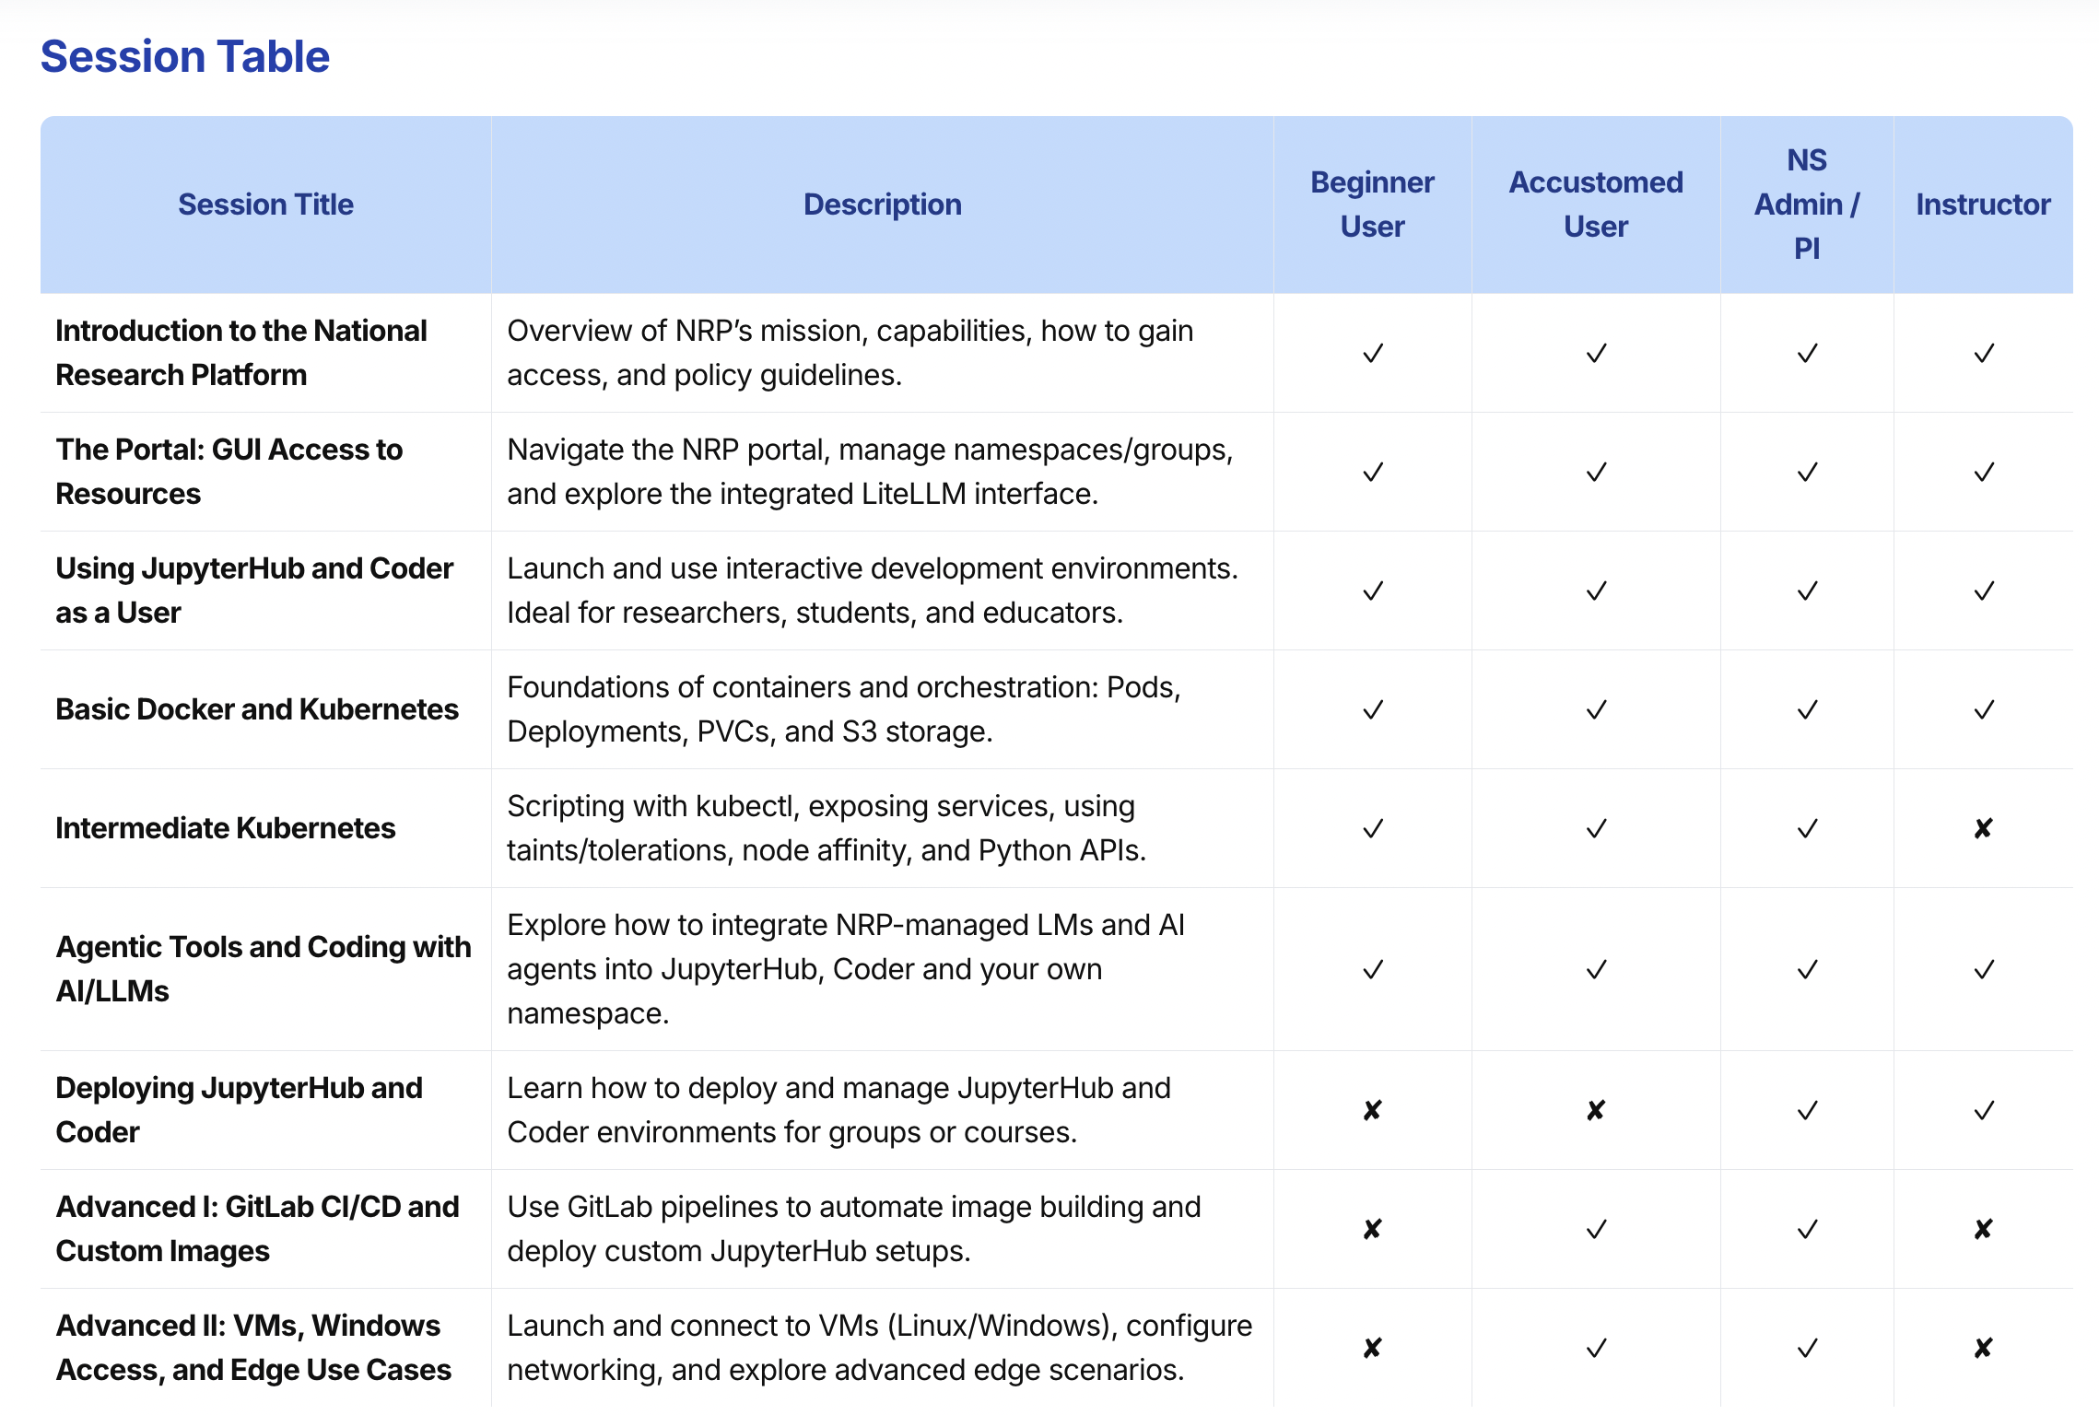
Last week
Today
Sep 23rd
Sep 30th

Slide 4
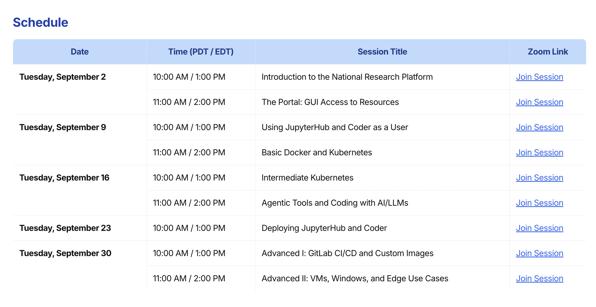
https://nrp.ai/training/

Slide 5

This Session
Both NRP’s JH & Coder run in k8s
NRP = Nautilus = Cluster
In Nautilus, namespaces are group/project scopes
JupyterHub and Coder each run in their own namespaces
Users can deploy their own instances of JupyterHub and Coder
Deployed services can have ingress: XYZ.nrp-nautilus.io
Making sure everyone is part of a group
Using JupyterHub
Using Coder
Next Session
Using Kubernetes Directly on Nautilus

Slide 6
Important Notice
This training is intended as a supplement to the official NRP Documentation.
While the content presented here is accurate as of today, the official documentation is the primary and most up-to-date source of truth.
Please refer to https://nrp.ai/documentation/ for the latest information and updates.

Slide 7


Using Nautilus and NRP
JupyterHub
Coder
Kubernetes
To access any of these services, you need to be part of a namespace/group on: https://nrp.ai/namespaces/

Slide 8
Using NRP’s JupyterHub
National Research Platform Fall Training Series

Slide 9
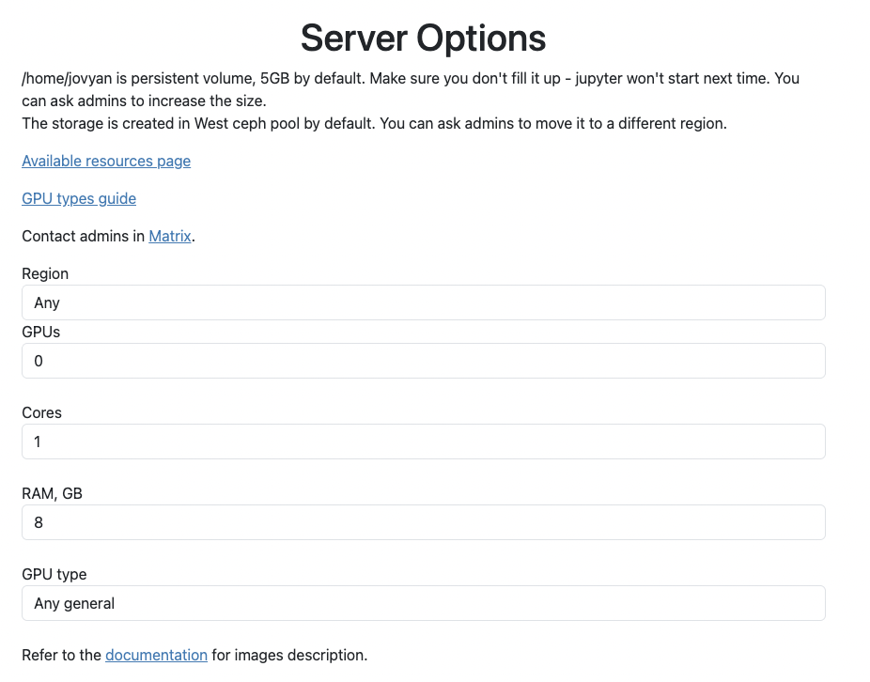
JupyterHub
https://jupyterhub-west.nrp-nautilus.io/
https://jupyterhub-east.nrp-nautilus.io/
We host two JupyterHub instances
Login via CILogon with your university credentials
You can choose resources like CPUs, GPUs, GPU type, RAM, etc
NRP provides several pre-built images
Read our docs to learn more: https://nrp.ai/documentation/userdocs/jupyter/jupyterhub-service/

Slide 10
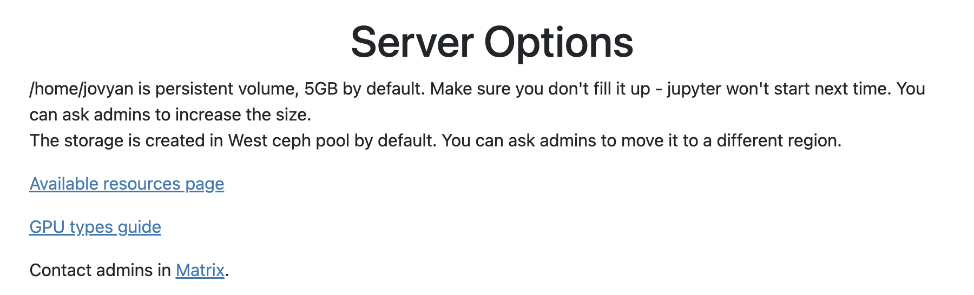



JupyterHub
Worker/Compute Node
Storage Node
5GB in West Region (US West Coast)

Slide 11

JupyterHub
Different Kind of GPU
In Wrong Region
Not Enough Mem
Not Enough CPU
Not Enough CPU
Reservation
Currently Offline
Not Enough Mem
Reserved for storage
Not Enough CPU
Not Enough CPU
Not Enough CPU
Eligible
Eligible
Different Kind of GPU
Eligible
Not Enough CPU
Not Enough CPU

Slide 12
JupyterHub
Different Kind of GPU
In Wrong Region
The JupyterHub instance is a Kubernetes pod (a Docker container).
There needs to be a node that:
Has the required resources as free
Is not tainted
For real-time view of nodes and resources: https://nrp.ai/viz/resources/
Not Enough CPU
Not Enough Mem
Not Enough CPU
Reservation
Currently Offline
Not Enough Mem
Reserved for storage
Not Enough CPU
Not Enough CPU
Not Enough CPU
Eligible
Eligible
Different Kind of GPU
Eligible
Not Enough CPU
Not Enough CPU

Slide 13
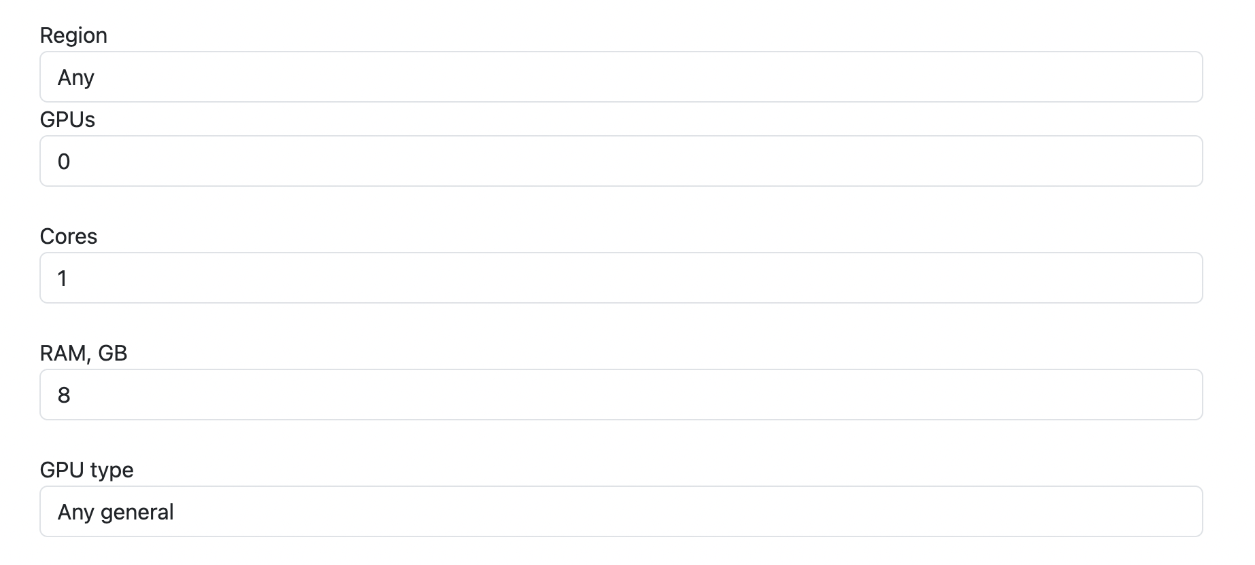
JupyterHub

Slide 14
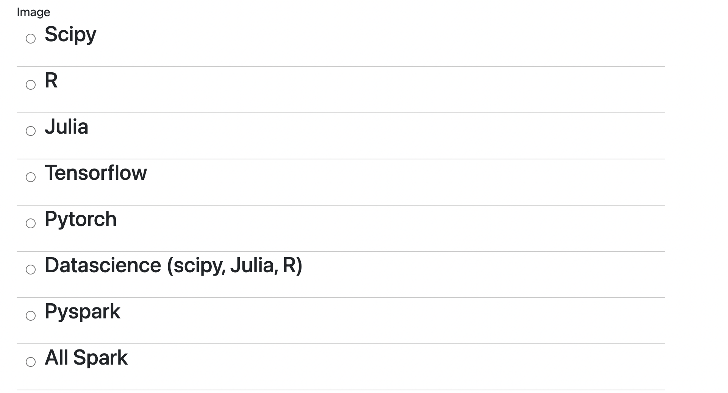
JupyterHub Images: Official Jupyter Images

Slide 15
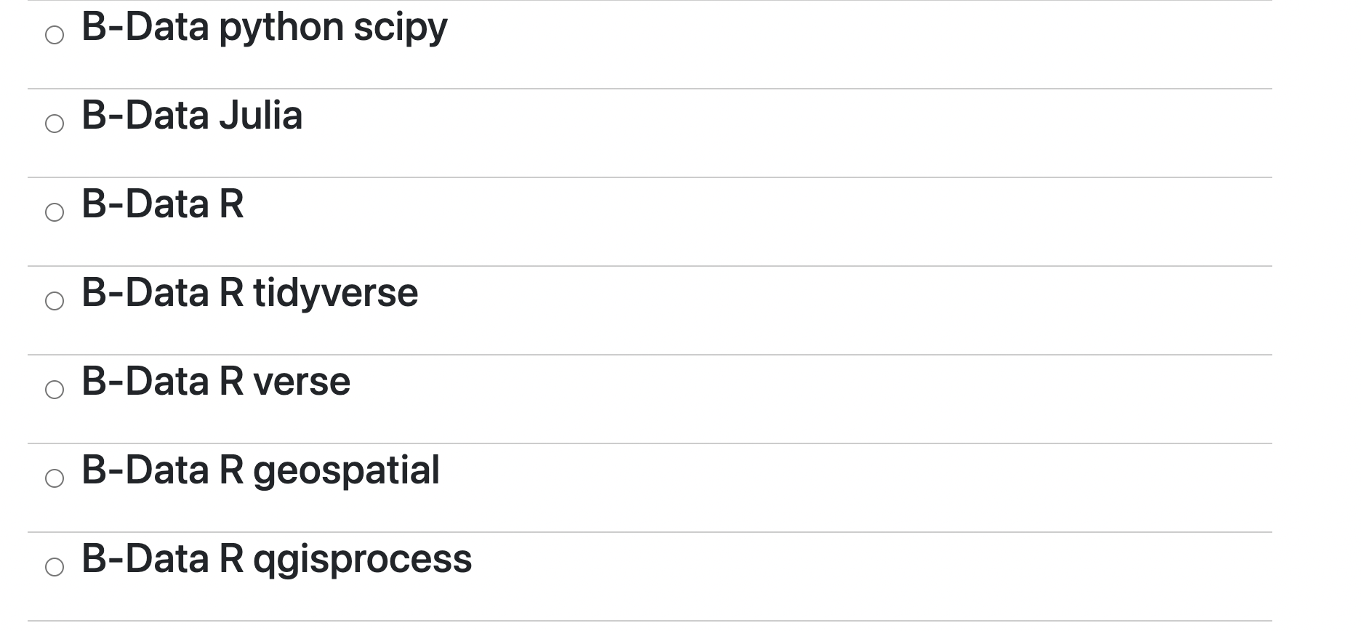
JupyterHub Images: B-Data Images

Slide 16
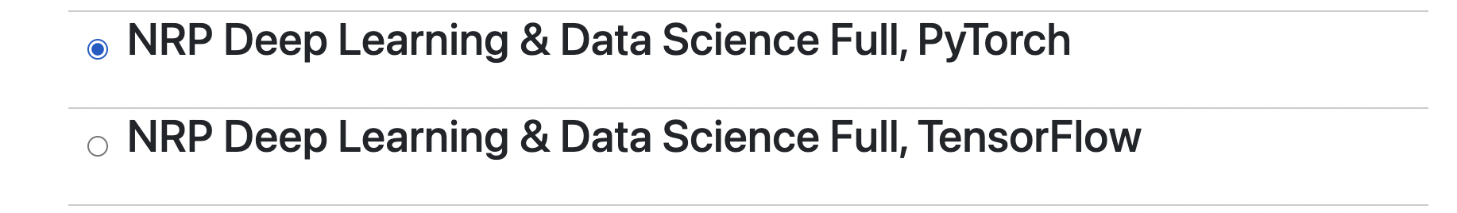
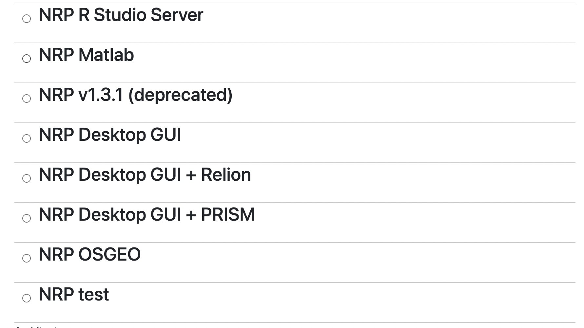
JupyterHub Images: NRP’s Images
Intelligent Spawner: Requesting GPUs starts images with CUDA configured and enabled for GPU-acceleration, 0 GPUs -> CPU libraries
Fully open-source and available on NRP’s community Gitlab
Made by NRP for NRP
Selkies-GStreamer:
Full Desktop Environments
WebRTC Streaming Client in Browser
CPU-acceleration/GPU-acceleration
Audio Enabled
Open-source, community-driven, community on NRP

Slide 17
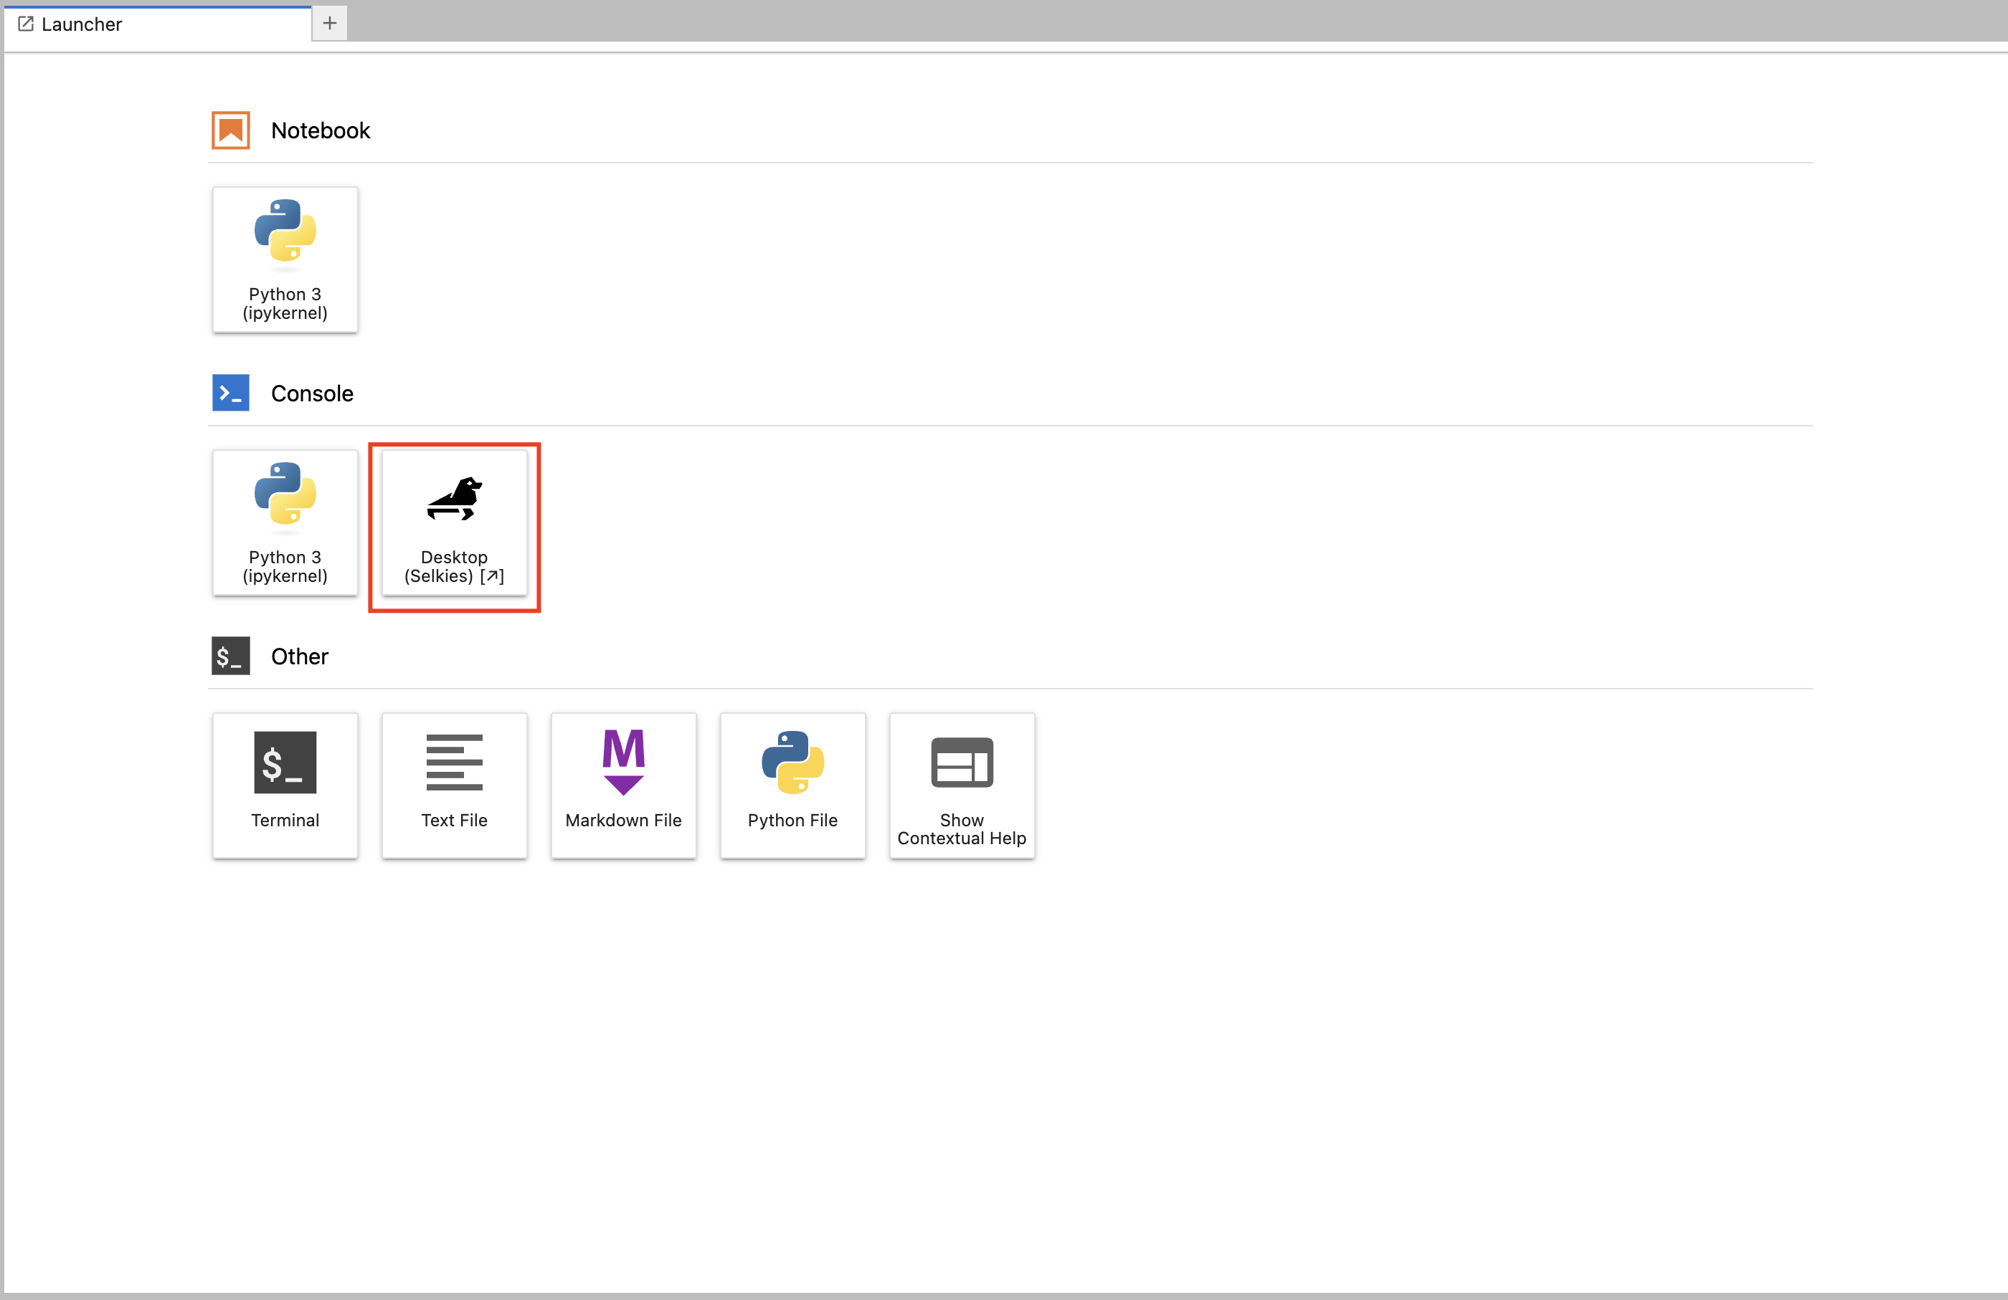
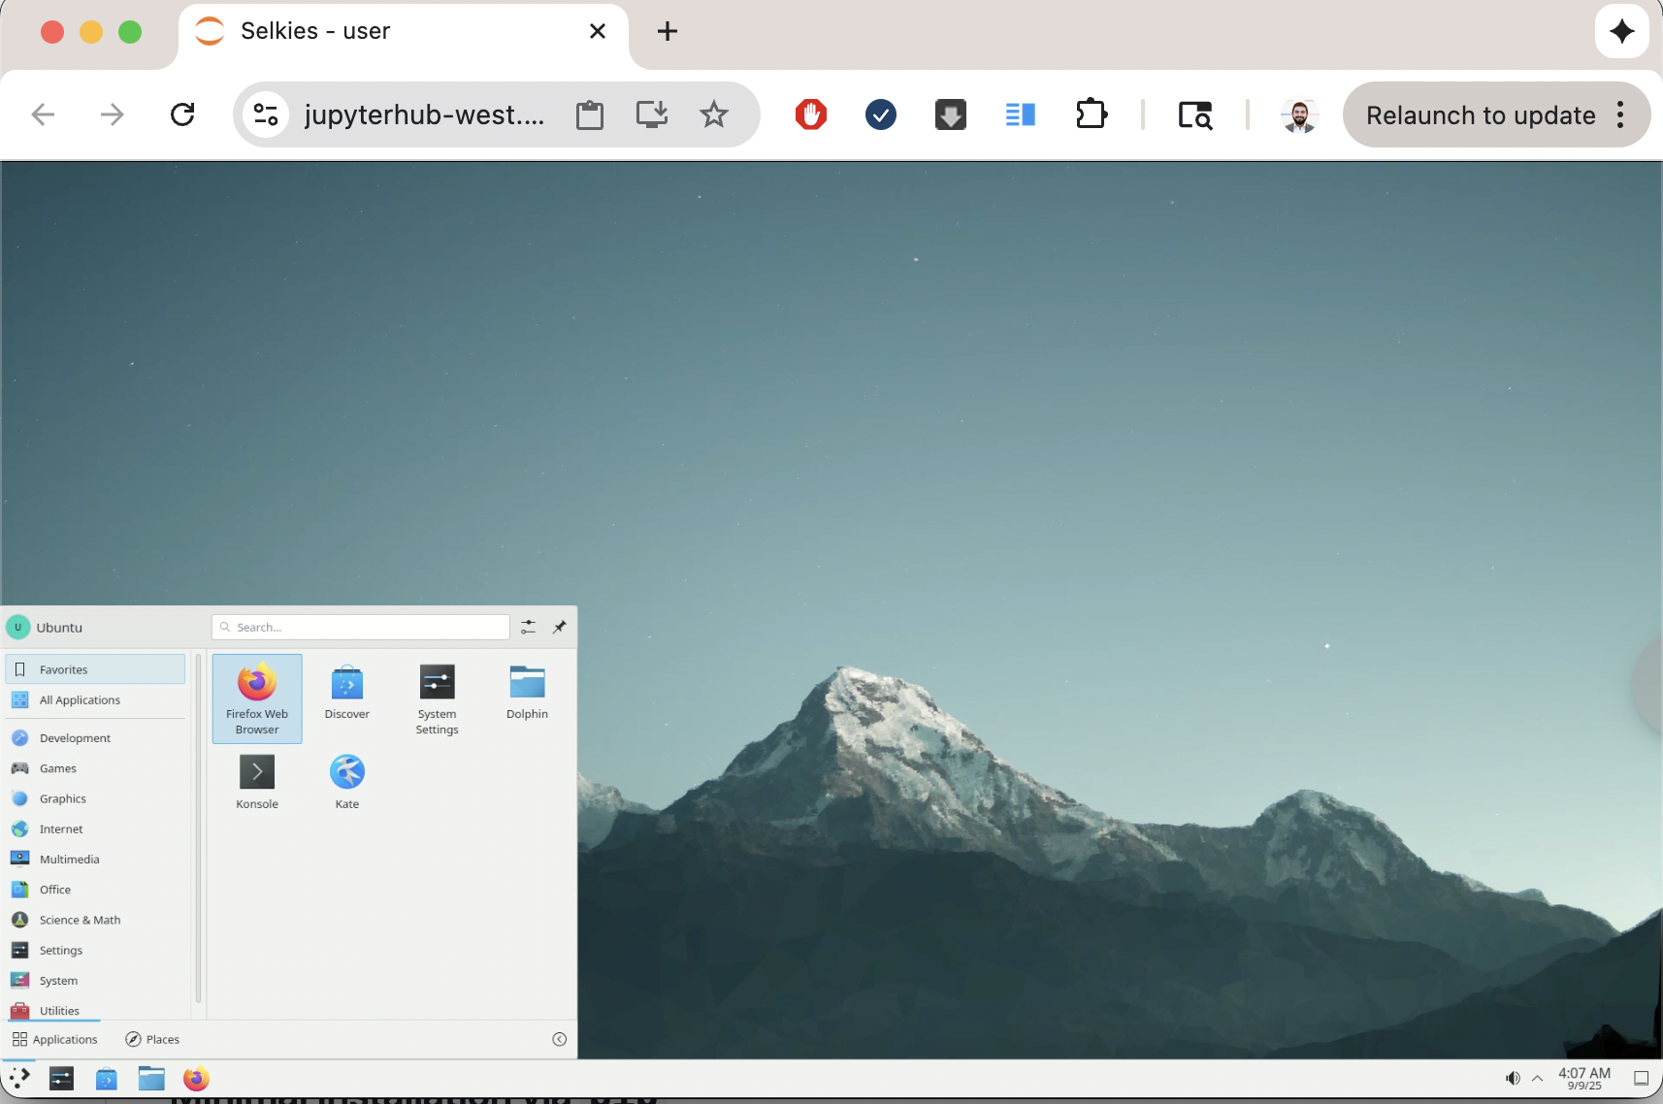
JupyterHub Images: NRP’s Images

Slide 18
JupyterHub Features
JupyterHub implements “culling”, not interacting with session will lead to auto-termination.
Jupyter-AI
Uses NRP’s LLMs (Free)
Provides Cell Debugging
Provides Entire Notebook Generation
Chatbot
Bring Your Own Provider

Slide 19
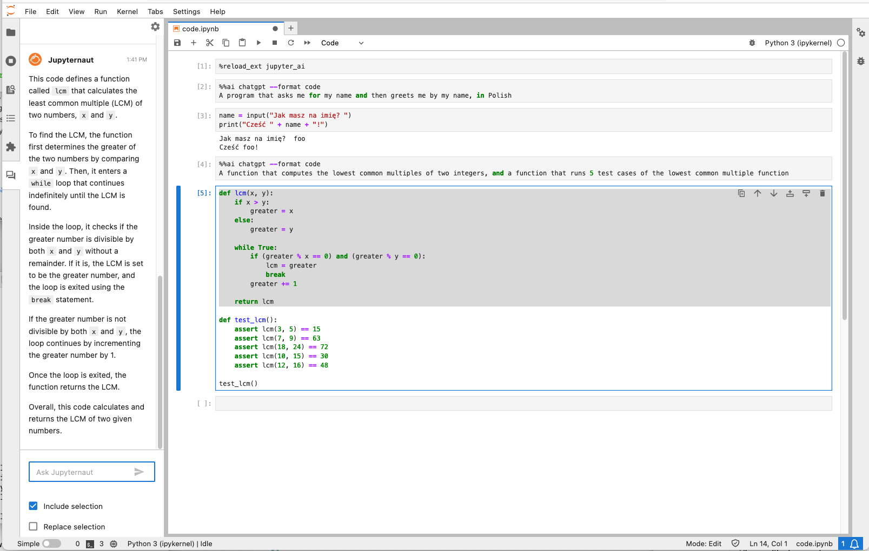
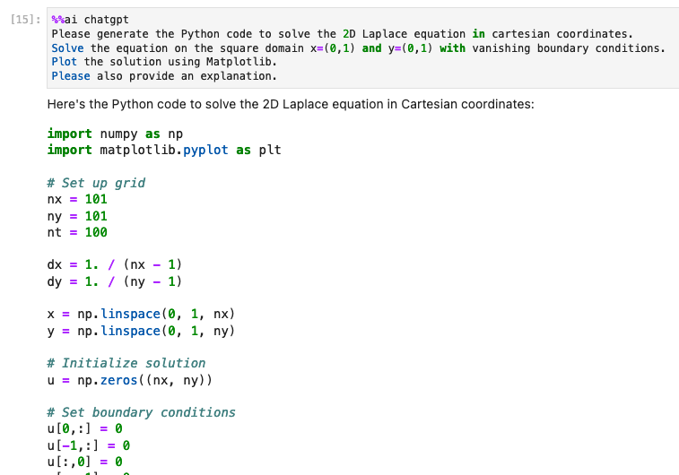
JupyterHub Features
Jupyter-AI
Jupyter Magics
Jupyternaut Side Panel
Sep 23rd

Slide 20
Let’s test it out for ourselves
National Research Platform Fall Training Series

Slide 21
Deploying your own JupyterHub
Admin control over Instance
Custom interface (branding, pickers)
Customized logic:
PVC default size
Shared volumes
Default Region
Customized access
Customized domain (Bring your own domain, XYZ.nrp-nautilus.io)
Custom Docker Images
Sep 30th

Slide 22
Using NRP’s Coder
National Research Platform Fall Training Series

Slide 23
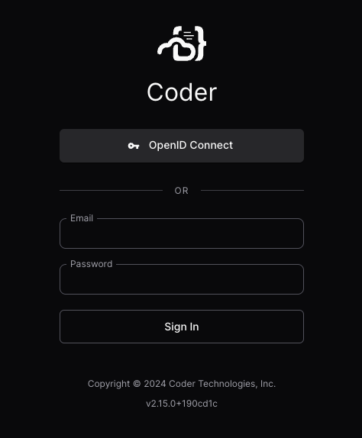
Coder
https://coder.nrp-nautilus.io/
We host a Coder instances
Login via CILogon with your university credentials
You can choose resources like CPUs, GPUs, GPU type, RAM, etc
NRP provides multiple templates
Read our docs to learn more: https://nrp.ai/documentation/userdocs/coder/coder/

Slide 24

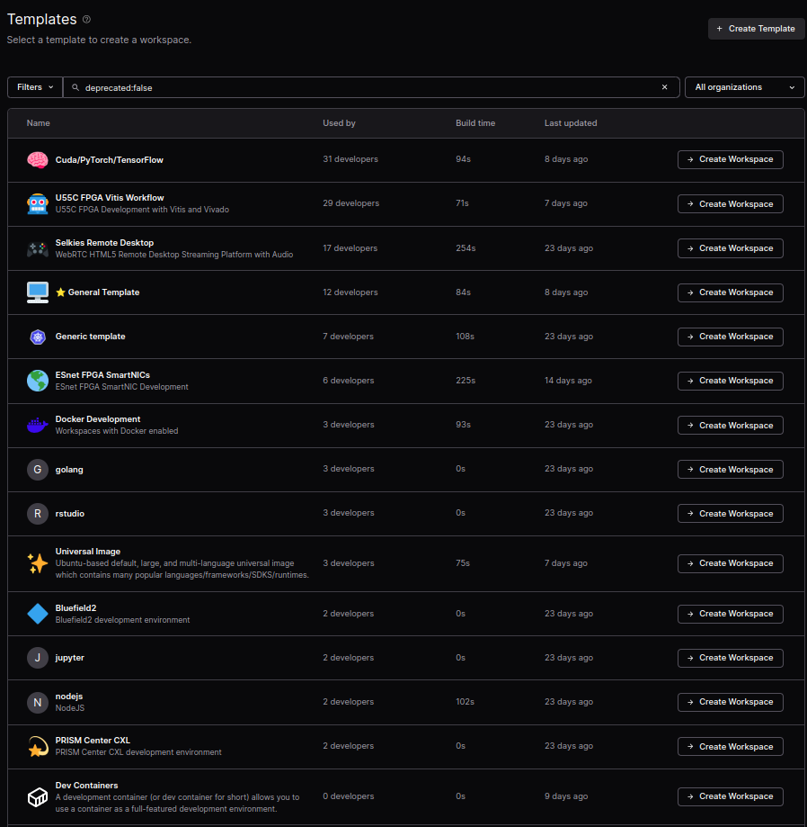
Access via Coder + FPGAs
Workspace = Personal Pod
Template = Image + Config
U55C FPGA Vitis Workflow
ESnet FPGA SmartNICs
Come preloaded with:
Xilinx Runtime Tools
Configuration to point to license server
Xilinx Tools (Vivado, Vitis, Vitis_HLS...)
Requests for Hardware
Read our Coder to learn more
https://docs.nationalresearchplatform.org/userdocs/coder/coder/

Slide 25
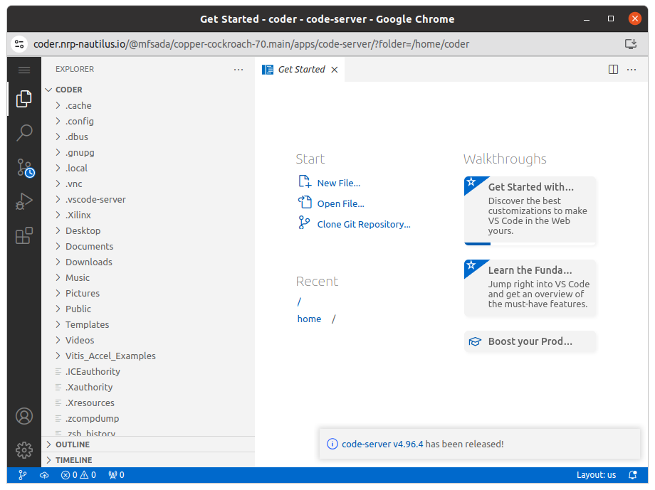
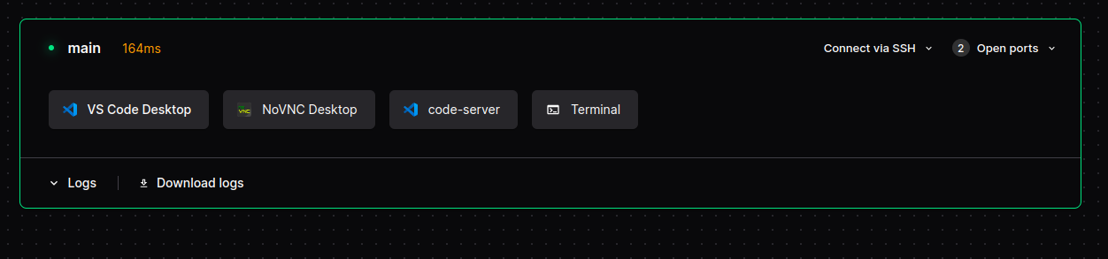
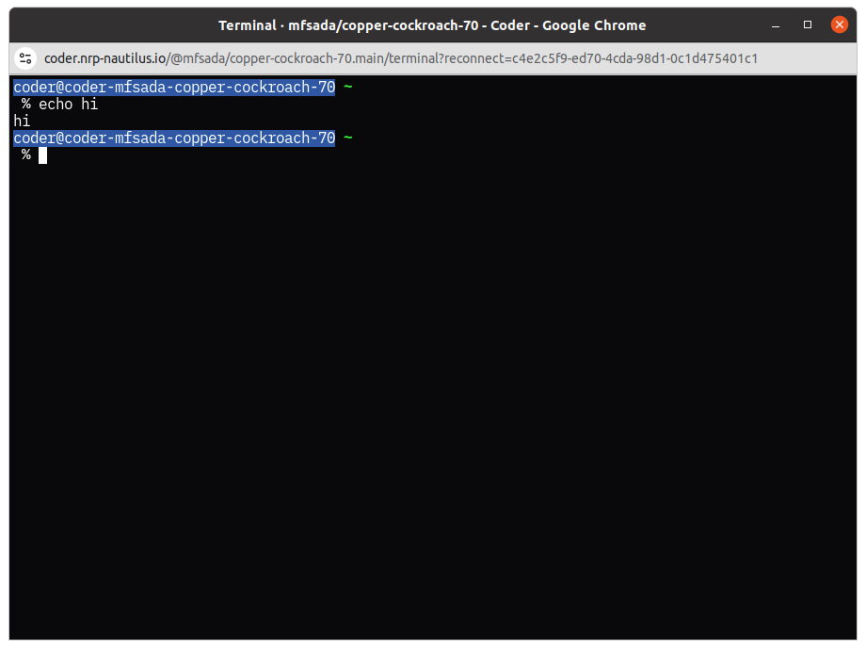
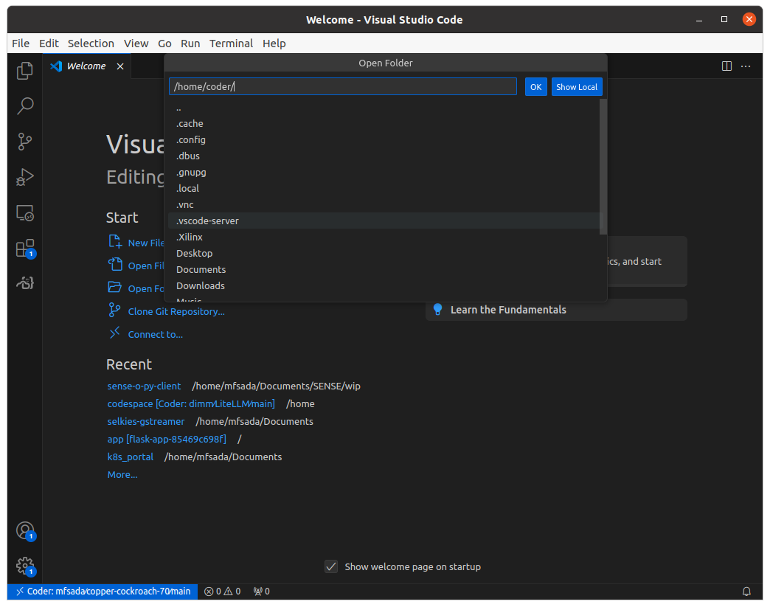
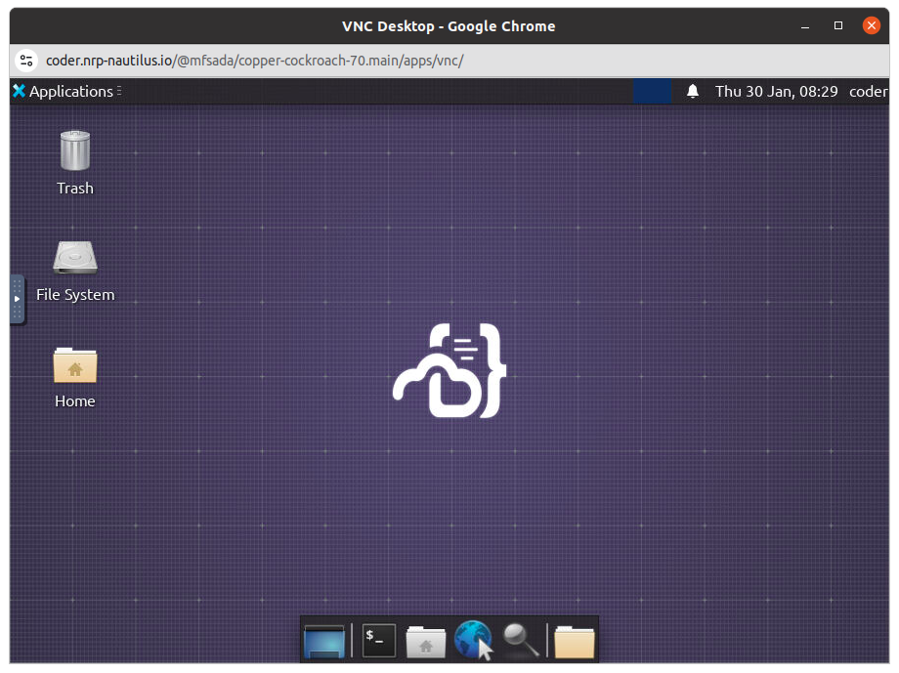
Coder
Features:
Custom Kubernetes Workflows with Terraform
(Pods, Deployments)
Remote Desktop in Browser
VS Code Desktop AND in Browser
Terminal in Browser
Persistent Personal SSH Key
Apps!

Slide 26
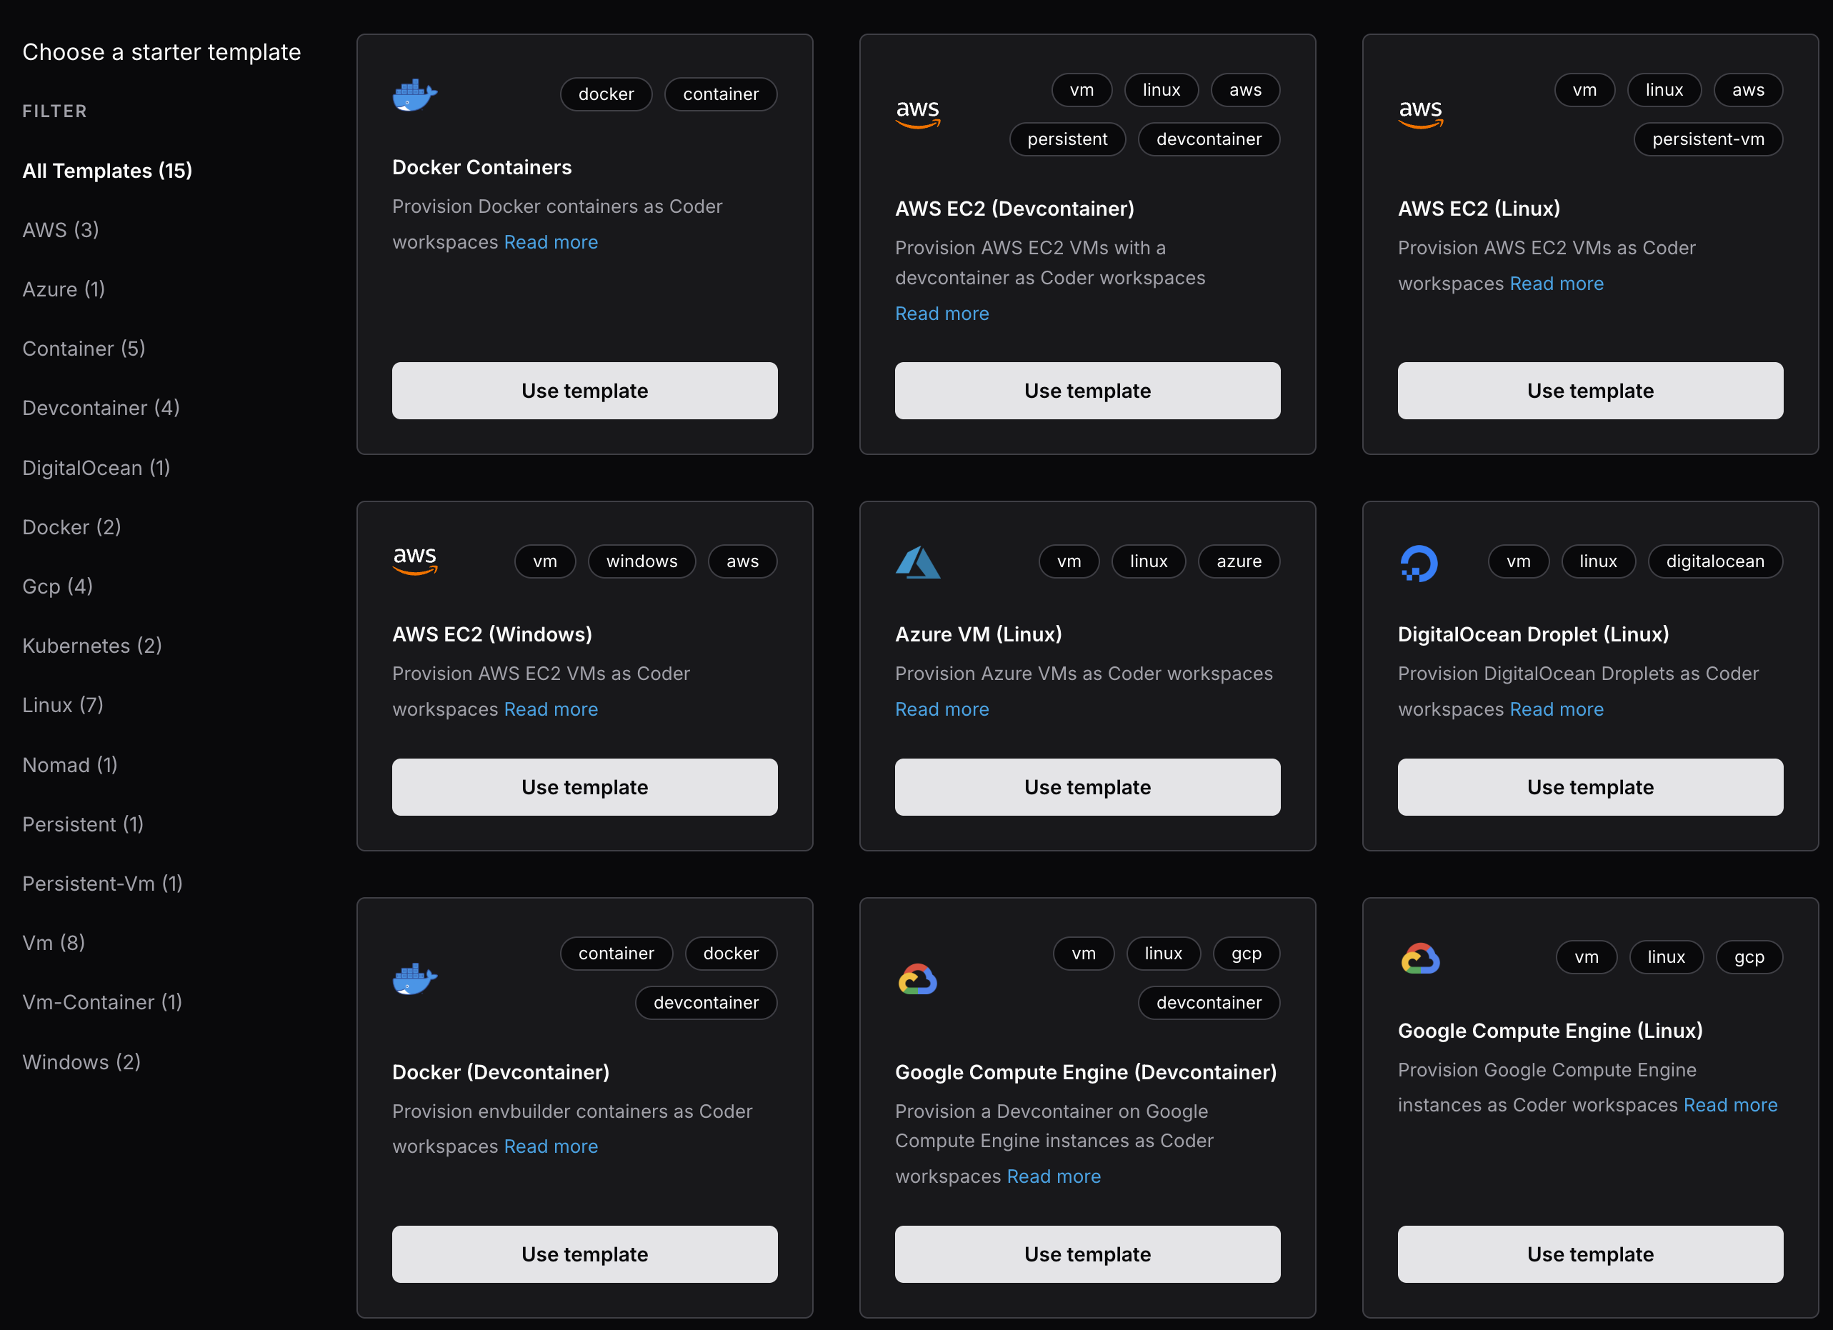
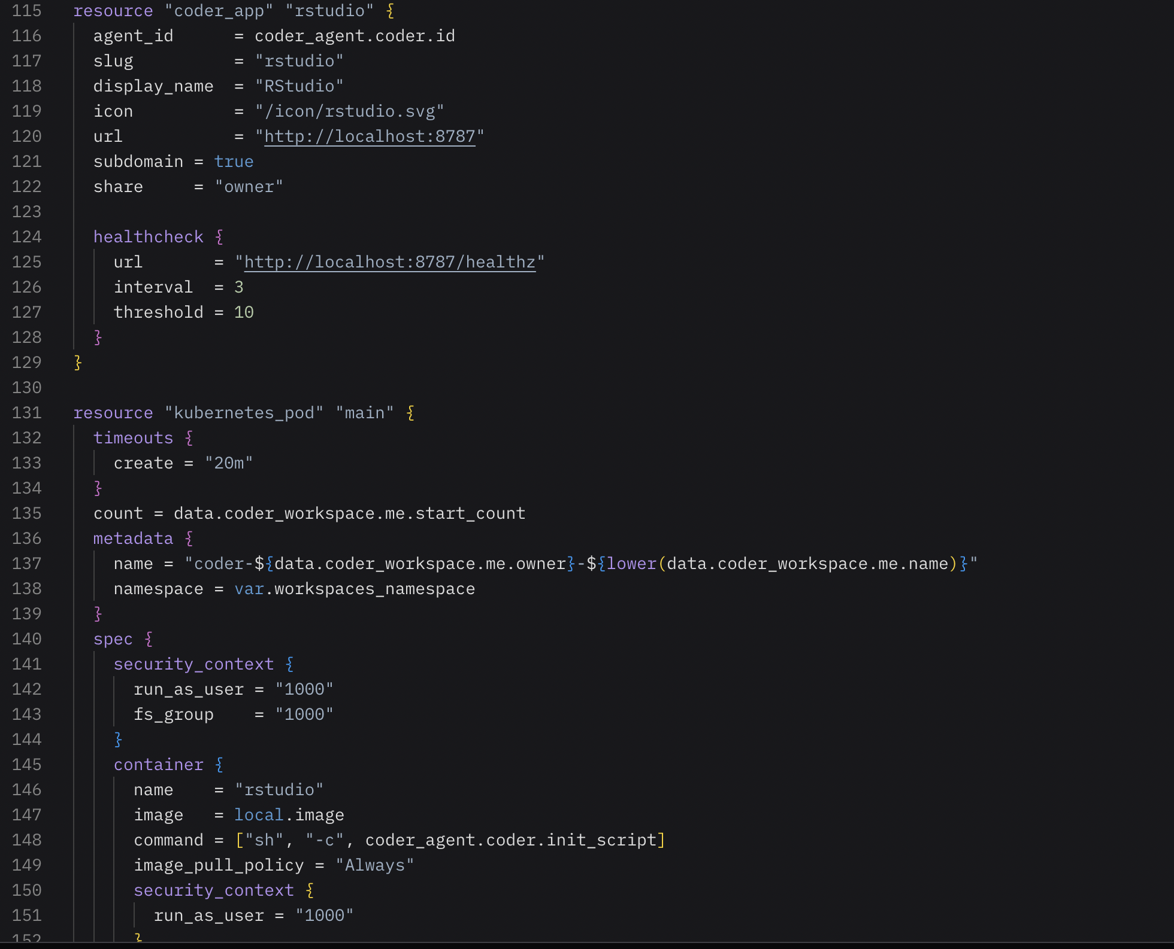
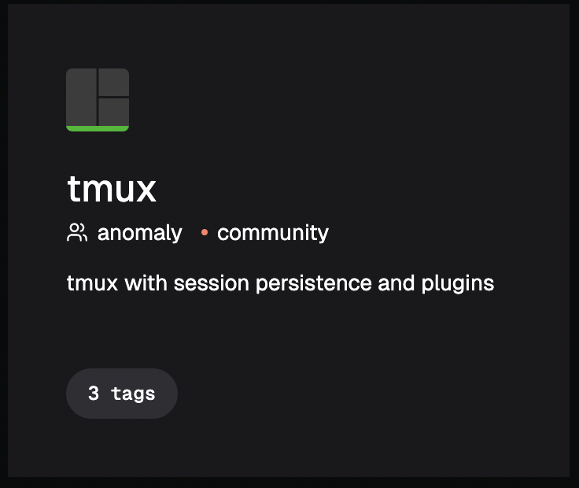
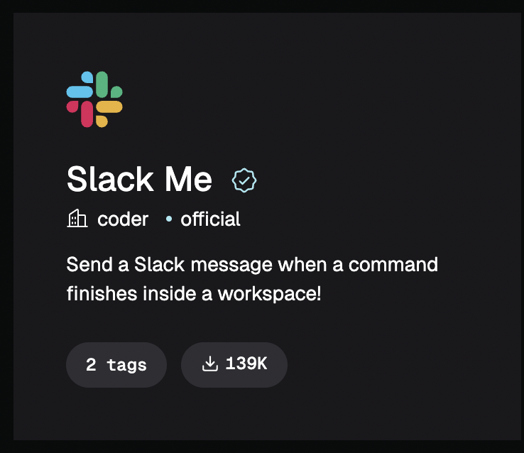
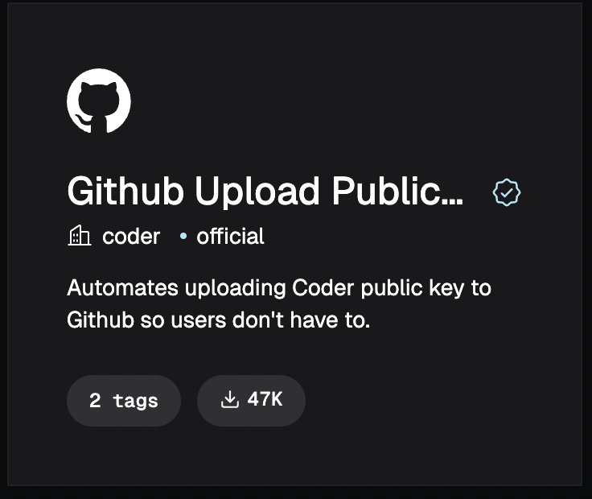
Terraform in Coder
Coder uses Terraform (HCL) not YAML

Slide 27
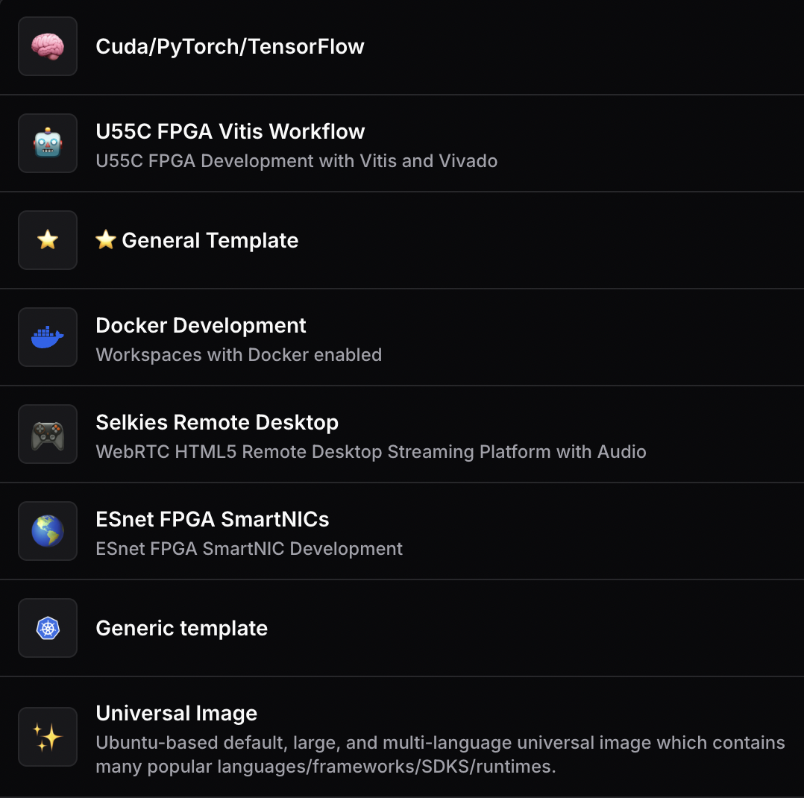
Coder Templates

Slide 28
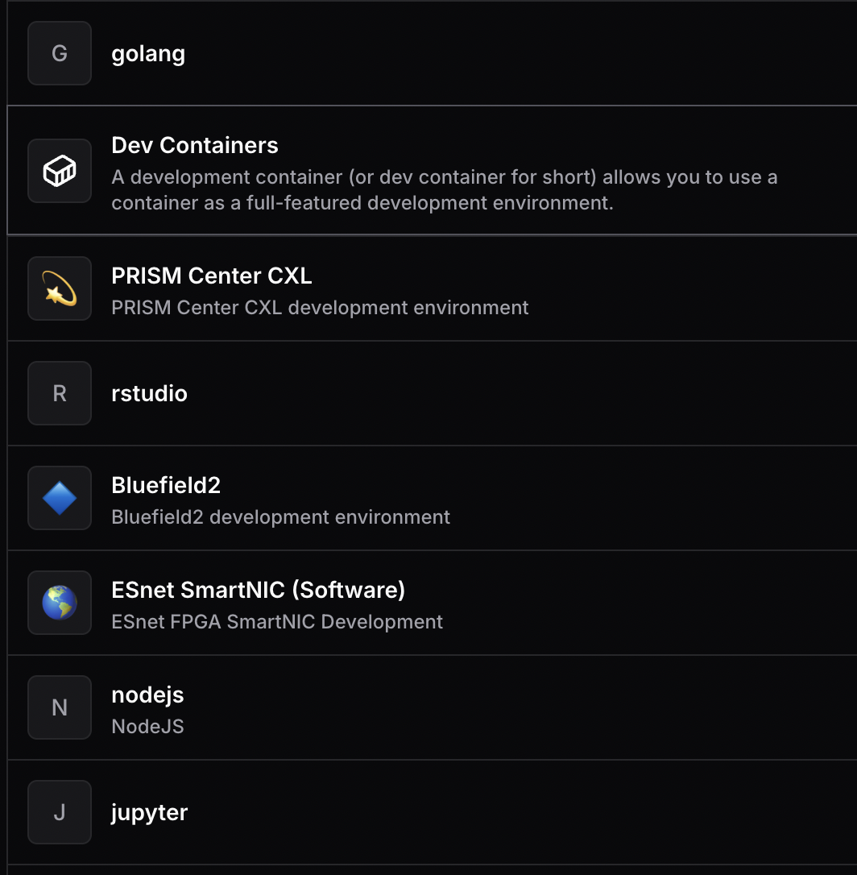
Coder Templates

Slide 29
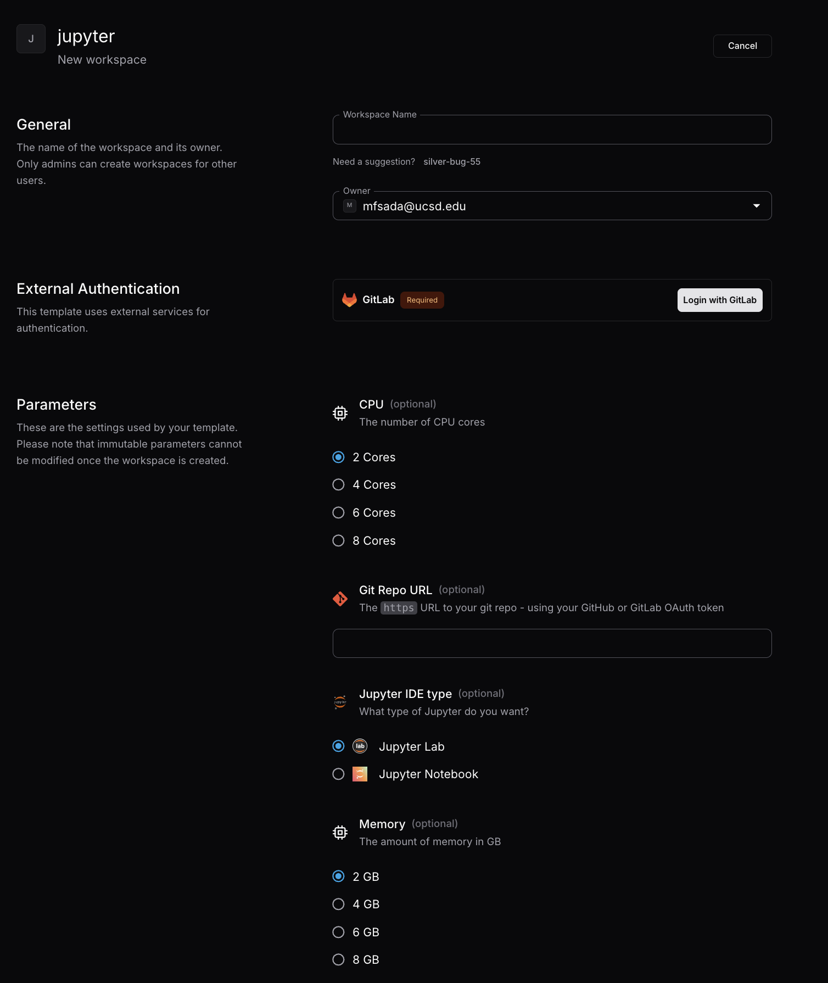
Coder Templates

Slide 30
Deploying your own Coder
Admin control over Instance
Customized logic:
PVC default size
Shared volumes
Default Region
Customized access
Customized domain (Bring your own domain, XYZ.nrp-nautilus.io)
Custom Terraform Providers/Modules + Custom Images
Sep 30th

Slide 31
Deploying your own Coder
JupyterHub: Server Instance = Kubernetes Pod 1 per user at a time
Coder: Workspace = anything you (admin) want it to be*
For us, that’s normally Kubernetes Pod + Kubernetes PVC with IDE integration and JH/noVNC/Selkies
For you, it could be whatever you want:
Cloud be a pod with JetBrains
Could be a public cloud resource
Could be a deployment/batch job
Could be a PostgreSQL database (Zalando Operator)
Cloud be a pod + service + ingress
If you can do it Kubernetes YAML, you can do it in Coder Terraform Templates**
* as defined in your Terraform templates
** provided there are public Terraform providers and/or modules for that functionality

Slide 32
Let’s test it out for ourselves
National Research Platform Fall Training Series

Slide 33
Using Kubernetes on Nautilus
National Research Platform Fall Training Series

Slide 34

Q&A
National Research Platform Fall Training Series

